Slide 1
Week 1 - AP Macroeconomics

Slide 2


What are we studying this year?
Economics
The study of how to use our scarce resources and make decisions for the benefit of society. Macro has a more national and global focus compared to micro.
This course is about establishing the basic ideas of economics.
There will not be much maths or modelling.
Class Goals
to prepare students for the AP Macroeconomics exam
to provide a general understanding of Economics to prepare you for business related majors at a college level
to practice and reinforce learning in an English immersion classroom as well as use of English textbooks

Slide 3
Is Economics a Science?
No, more of a Social Science
In spirit, yes—hypothesize, test, refine—but the economy is messy (no fully controlled experiments).
Because we cannot do proper experiments, we often try to form models that can help, but do not fully explain the real world.
Because it is not a testable science, economists can disagree on many things, especially things that are more political in nature.
Ideas that most economists agree on
Policy should improve public well-being.
People respond to incentives (reasons for acting).
Voluntary exchange (without violence) tends to be beneficial for both people.
We can analyze the costs and benefits of many situations.

Slide 4

How Economists Work
What Tools do Economists Have?:
  Theory + math, statistics, data, and causal reasoning to answer “what if” questions (cost–benefit, cause–effect).
    Note: This is more for university economics and beyond! In this course we are establishing the basic ideas of economics.
Economist Careers
  Economists work in government, academia, finance, consulting, NGOs, etc. The field is broad (JEL classification spans many subfields).

Slide 5
Course Information
Refer to the handout.

Slide 6
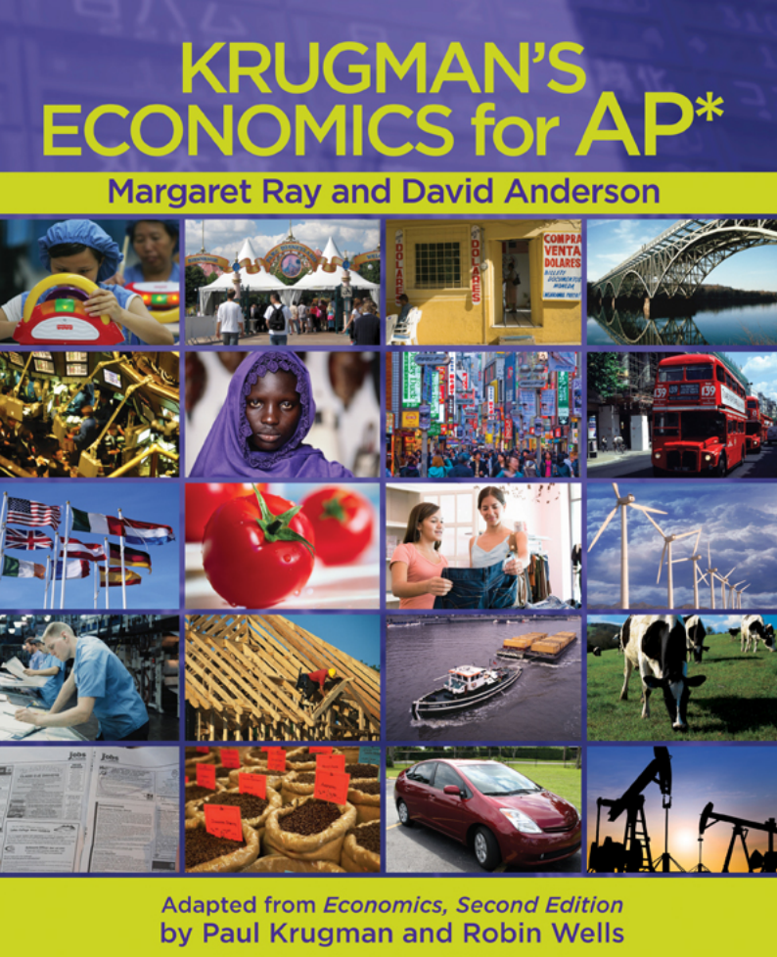
Textbook
Answers to many of the papers from class are in the back of this book.
I will also give many extra practice questions.

Slide 7
AP Macro Exam Information

Slide 8
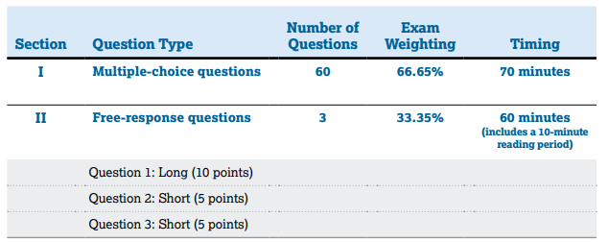
AP Exam Format

Slide 9
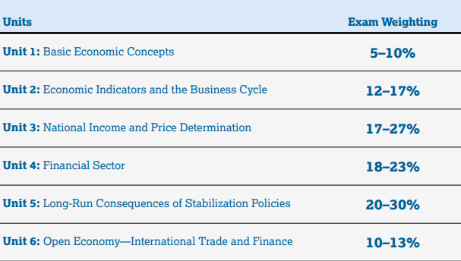
Exam Content

Slide 10
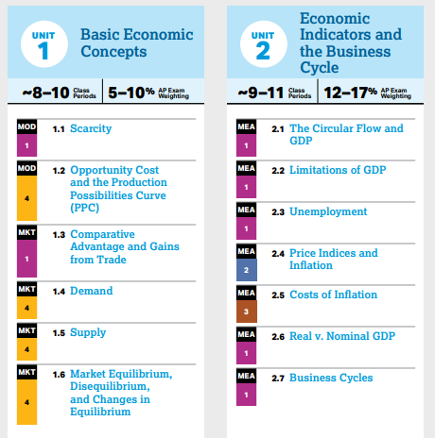
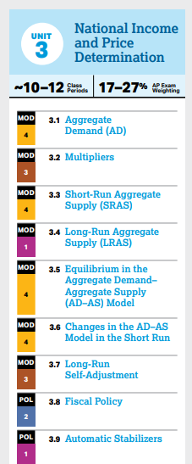

Slide 11
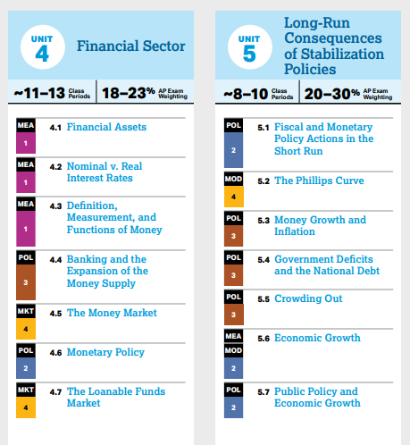
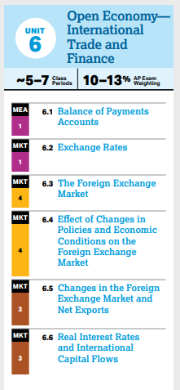

Slide 12
Unit Difficulties
Unit 1
Easy
Same as micro
Unit 2
The most fun unit
Unit 3
The foundation of the whole course.
  You need to focus.
Not too difficult.
Unit 4
2nd Hardest unit
Builds on Unit 4
If you master Units 3 and 4 this is a huge help
Unit 5
Hardest Unit
Builds on unit 3 and 4
Unit 6
Not too difficult
Brings many things from the previous units together
Don’t fall behind during Unit 3 and 4.

Slide 13
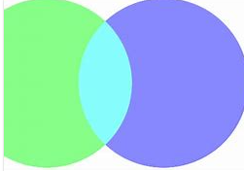
Unit 1 AP Macro
Unit 1 is the same for AP Micro and Macro!
  Scarcity
  Opportunity Cost
  The Production Possibilities Curve
  Comparative Advantage
  Demand
  Supply
  (Demand and Supply) Equilibrium
If you took Micro:
  I can give you some chapters that you can read ahead (optional)
  Otherwise you can relax a little and review what you learned.
Expect a reasonable amount of overlap between Microeconomics and Macroeconomics! Especially in Unit 1 where there is almost total overlap.

Slide 14
AP Micro Exam Information

Slide 15
AP Exam Format
Same as AP Macro!

Slide 16
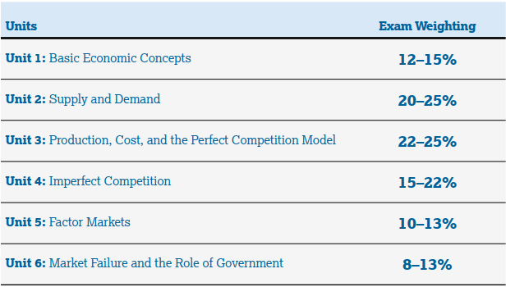
Units and Exam Weighting

Slide 17
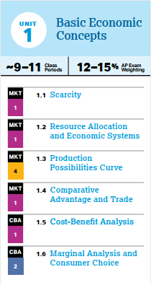
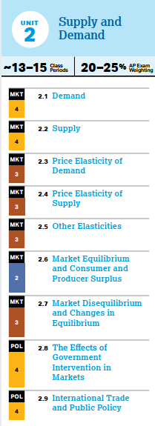
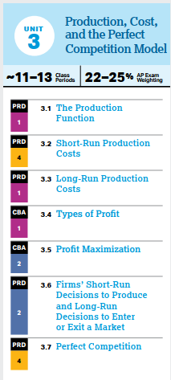
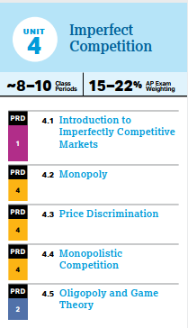

Slide 18
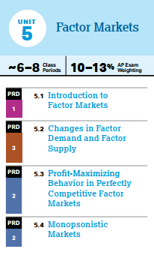
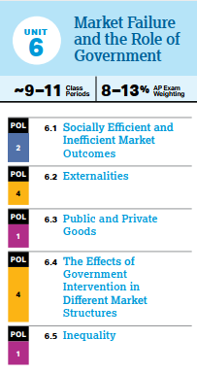

Slide 19
Academic Expectations
Grading
Quizzes - 40%
Midterm-20%
Final-20%
HW-10%
Class Participation – 10%
Students should aim to understand the core models
  Memorization is NOT a good strategy
  Students should try to add layers of information gradually
    If you paint a wall, you should allow one coat of paint to dry before you add the next one.
  Many concepts build on previous concepts
Asking questions in and out of class is very useful as it can allow things to ‘click’
Finding alternate explanations can also be very useful
  Sometimes seeing a concept explained from ‘different angles’ can really help
Once you understand the basic ideas, try to do the exercises
  Sometimes even if you understand the PPT it is another step to be able to do the questions
Conclusion: How to Succeed
Aim to understand, not memorize
Ask questions!
Find ways to apply the concepts
Regular study, as in most subjects, is key!

Slide 20
Class Rules
No computers or tablets in class
  If a student proves they are responsible I may let them use a computer
Do the exercises in class
No retakes of quizzes, but they will be curved

Slide 21





About Me
Graduated from the Australian National University
  Bachelor of Economics, 2015
Taught in China, the Middle-East, Latin America, Austria, United Kingdom
Hobbies
  badminton, tennis, basketball, exercise, stock market investing, learning Chinese

Slide 22
Get to Know You Handout.
Complete the handout that asks some ‘get to know you’ questions.

Slide 23
Wechat group
Add me: davidryanact
You can use Wechat to ask me questions, ask for materials etc.

Slide 24
Website
I have made a website: www.learningwithdavid.com
  It has:
    PPTs
    Exercises from class
    Revision Materials
    Practice Exams
  Does not have:
    Your quizzes

Slide 25
Course Starts Now…

Slide 26
Learning Objectives Checklist
Fundamental definition of the study of economics
Microeconomics vs Macroeconomics
Main Economic Systems
  Market Economy, Planned Economy, Mixed Economy
Factors of Production
  Land, Labor, Capital, Enterprise
The Fundamental Economic Problem
Opportunity Cost

Slide 27


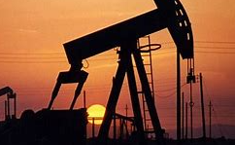
What is Economics?
Scarce = Limited = Finite
Most (or arguably all) resources are limited/finite/scarce so they must be used efficiently.
Economics is a very wide field that covers money, psychology, human progress etc. But if we define economics in a sentence:
Economics is about the efficient use of limited resources.
Activity: List some limited resources.
Oil
Coal
Gas
Steel
Time
Rare Earth Minerals
Trees
Oxygen
Fish
People
Land
Summary
The most basic definition of economics is – the study of the use of scarce resources.

Slide 28
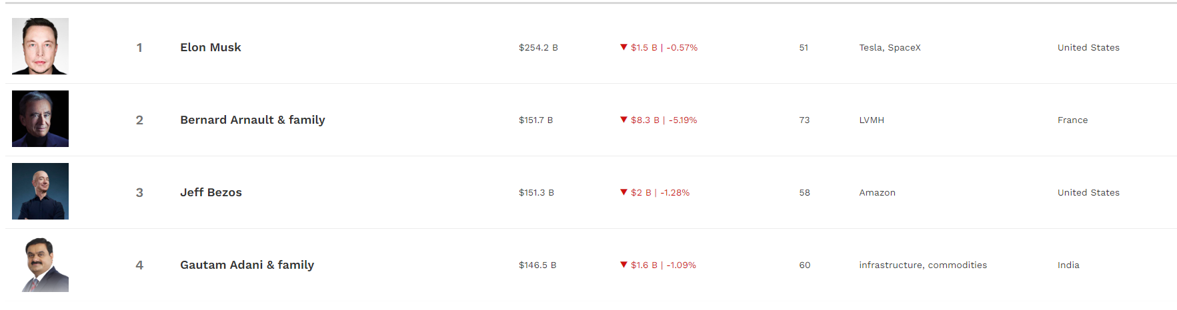
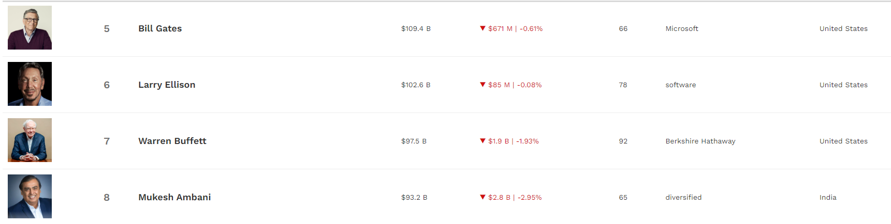
Even Rich People Have Scarcity
Less scarcity than others but they cannot buy more time, they cannot buy whole countries, they cannot live forever, they cannot control the weather etc. Therefore, everyone has scarcity.

Slide 29


Micro vs. Macro
Microeconomics = concerned with economic decisions of individuals and individual entities (eg. businesses)
Macroeconomics = concerned with economic decisions on a national, regional and global level
  Issues such as:
    Unemployment
    Inflation
    Economic Growth
    Government Policies to prevent recessions
    Trade
    Exchange Rates
  Micro = small
  Macro = big

Slide 30
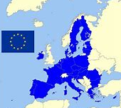

Microeconomic Versus Macroeconomic Questions
Microeconomic Question Examples
Should I go to college or get a job after high school?
What determines the salary that Citibank offers to a new college graduate?
Macroeconomic Question Examples
How many people are employed in the economy as a whole this year?
What determines the overall salary levels paid to workers in a given year?

Slide 31
Macroeconomics or Microeconomics?
What determines the overall trade in goods, services, and financial assets between the United States and the rest of the world?
What determines the number of iPhones exported to France?
What government policies should be adopted to make it easier for low-income students to attend college?
What determines the cost to a high school of offering a new course?
What determines the overall level of prices in the economy as a whole?
What government policies should be adopted to promote employment and growth in the economy as a whole?
Macro
Micro – One company only
Micro – looking at a small group of people
Micro
Macro
Macro

Slide 32
What is the difference between macroeconomics and microeconomics?
Macroeconomics is concerned with the whole economy.
Microeconomics is concerned with individuals or groups within the economy.

Slide 33


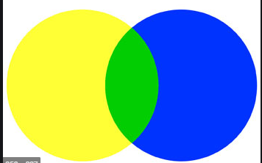
Main Economic Systems
An economic system answers the questions of:
  What to produce
  How to produce it
  For whom to produce
Market Economy
Planned/Centrally Planned
Mixed
Decisions are made by private businesses.
Decisions are made by the government.
This is a mix of the first two!
Decisions are made by private businesses and the government.
Almost all countries have this system.
Free market
Free enterprise
Capitalism
Command
State Run
Communism

Slide 34
Market vs Planned Economy – The Three Questions of An Economic System
Summary
The three economic questions are answered differently in the different economic systems.
Three questions of an economic system
What to produce: eg. How many houses, how many eggs, how many cars
How to produce: what methods should we use to produce?
For Whom: who gets to use/keep the things that we produce?

Slide 35
Market vs Planned Economy – The Three Questions of An Economic System
Summary
The three economic questions are answered differently in the different economic systems.
Free market economy
What to produce: individual business owner decides to produce paint brushes
How to produce: individual business decides to employ some labor, and use machines.
For Whom: the business sells to people who pay for the paint brushes
Planned Economy
What to produce: Government decides to produce 5 tonnes of corn
How to produce: Government gives everyone jobs and makes decisions about the methods of production.
For Whom: the government will give the corn to who they decide on

Slide 36
Activity
What are the three questions in an economic system?
What are 3 economic systems?
Most countries have a ____________ economic system.
1. What to produce, 2. how to produce, 3. for whom to produce.
Planned economy (government controlled), Market economy (privately controlled), Mixed economy (both)
mixed

Slide 37
Bonus: How are resources allocated?
Summary
Free markets – use prices to allocate resources
Planned – government allocates resources
Free Market Economy
Through prices.
The value of things are determined through price.
This way people know how valuable certain things are and can make more or less of them.
  However, unfortunately there are many things that have value which do not have a high price value. Eg. Helping the poor.
Eg. You realize that making shoes will give you more profit than making belts, so you and society will produce more shoes.
Planned Economy
The government makes decisions on what to produce.
The decisions are based on the tastes and observations of the government officials.
This is very challenging for a government to do efficiently.

Slide 38
In a free market economy, how can society decide what to produce without any control from government?
Through prices, people will know the price of different things and try to produce things that are most valuable/important.
Eg. things with a lower price value will be produced less and higher value more.

Slide 39
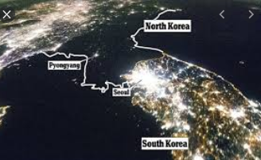
Which three countries do we see?
Link
Of course there are many factors to consider. But based on this photo, it does seem that a completely planned economy like North Korea’s can lead to a much slower economy.

Slide 40
Economic System Group Activity
Determine whether the industries given are free market, state run or mixed.

Slide 41
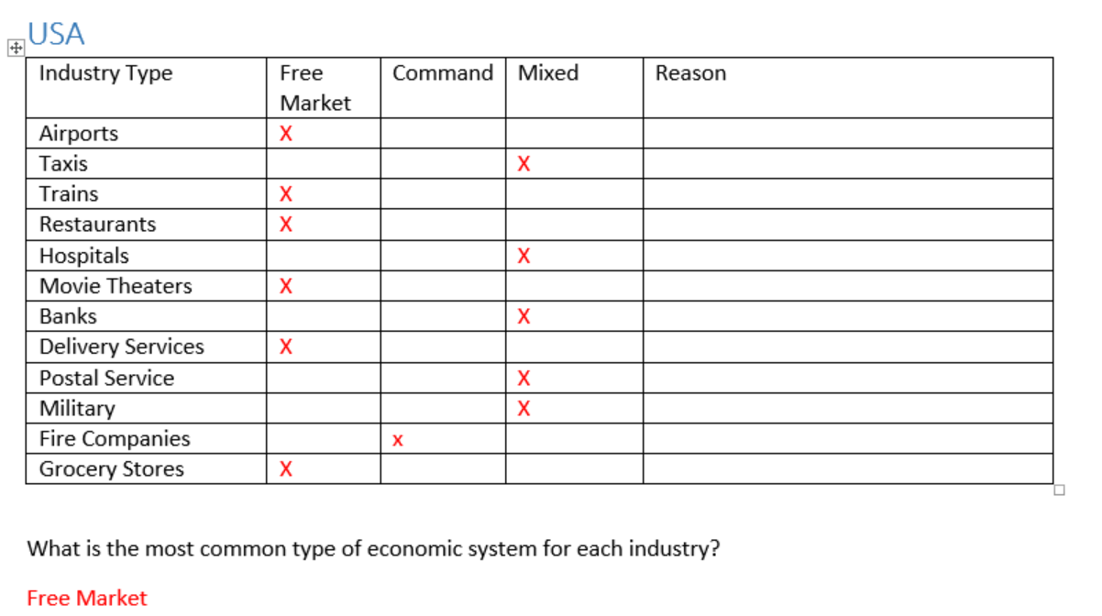

Slide 42
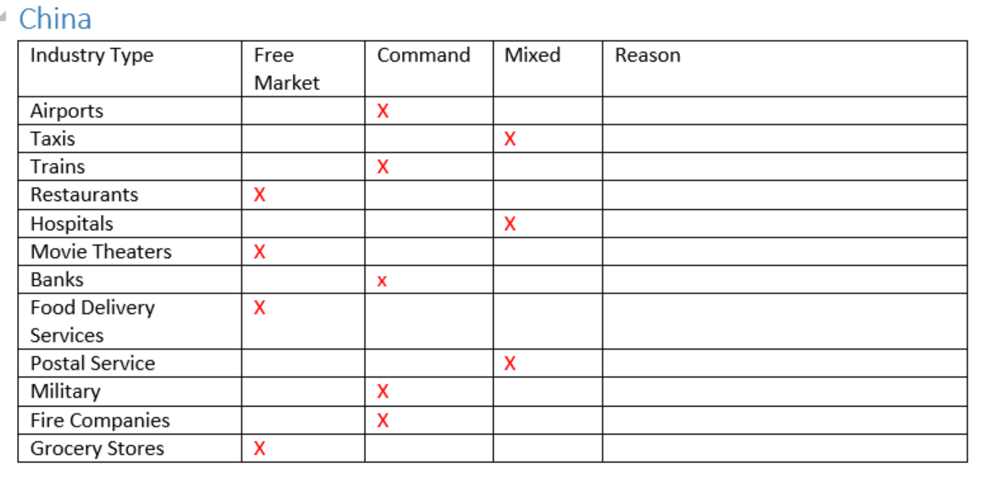

Slide 43
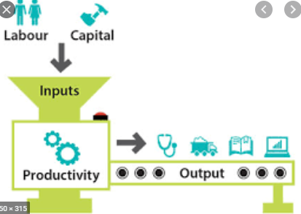

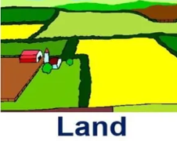



Factors of Production
Production
Resources (or inputs) are what businesses use to make the goods and services (or output).
This is called production.
We can put all business resources into four categories
  Land
  Labor
  Capital
  Enterprise
We call these the Factors of Production (FoP)
Summary:
Resources are used to make goods and services.
These are categorized as the factors or production (FoP) are land, labor, capital and enterprise.

Slide 44
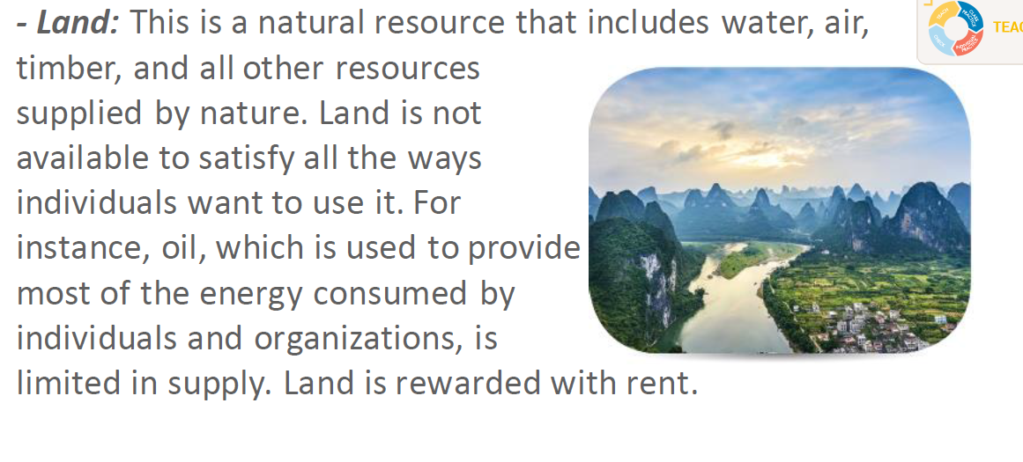
Summary:
Land is the resources that come from nature; in, on, and above the land.

Slide 45
Give an example of the resource: Land.
Oil underneath a piece of land.
Fish in the sea.
A piece of land used to build an apartment building.

Slide 46
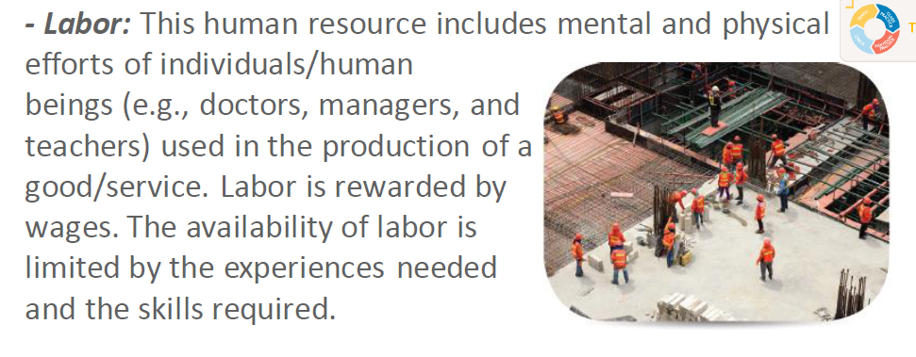
Summary:
Labor means the workers who use their physical and mental ability.

Slide 47
Give an example of the resource: Labor.
A teacher working at a school.
An accountant working in a firm.
A waiter at a restaurant.

Slide 48
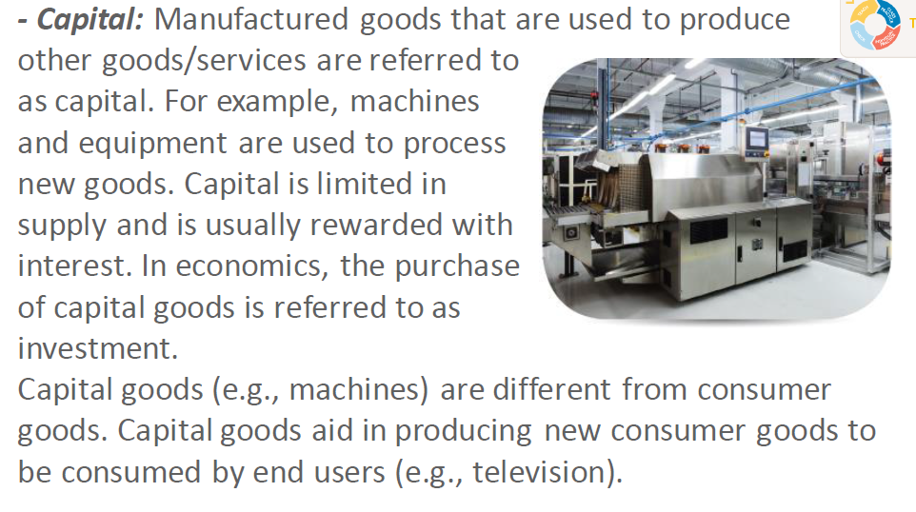
Note: We frequently refer to money as capital also. This is because money is always used to buy the things that a business needs.
Eg. A bank lends money (capital) to a business so it can purchase supplies, hire workers and buy equipment.
Summary:
Capital in this course typically means the machines and equipment that help businesses to produce.
(In later units we will see that capital also means another word for money.)

Slide 49

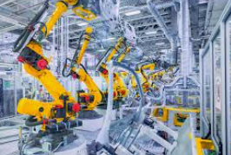

Capital Goods
Goods used to make other goods.
Remember that capital is one of the four types of resource/‘factors of production’
Capital goods are physical assets that a company uses in the production process to manufacture products and services that consumers will later use. Capital goods include buildings, machinery, equipment, vehicles, and tools.
Capital goods are not finished goods, instead, they are used to make finished goods. (Finished goods are what consumers buy!)
Capital goods include: buildings, machines, hand tools etc.
Summary
Capital goods are ‘goods that make other goods’. They are one of the four factors of production.

Slide 50
Give an example of the resource: Capital.
A piece of equipment used to trim hedges.
A bridge or road that helps transport goods.
Supplies used in production – eg. a bag of rice for a restaurant.
  This will be used to make the final product
Money borrowed from the bank. We often call this ‘raising capital’ (however this money will be used to buy things such as supplies, equipment and factories).

Slide 51
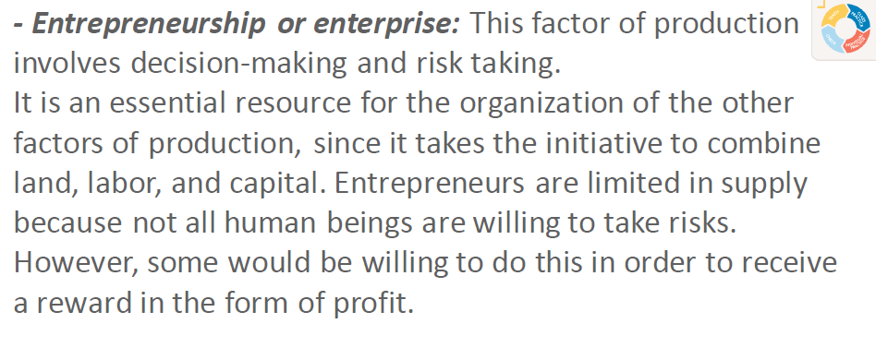

Slide 52



Enterprise
Summary
Enterprise means the people who own the business. Without enterprise, no businesses would exist. Enterprise allocates the other FoP.
Enterprise
Enterprise is the ‘magic’ that brings materials, equipment and people and turns it into a business.
All businesses are started by entrepreneurs.
Any owner or part owner of a business is also an entrepreneur.

Slide 53
Give an example of the resource: Enterprise.
You open a hairdressing salon and cut hair.
The owner of a business decides to expand.
A wealthy man invests in a starting business and owns 50% of the business.
You buy stocks in Baidu. (You are now a part owner of the business and can vote on how the business is run.)

Slide 54
What are the four factors of production?
Land, labor, capital, enterprise
Which of the factors of production is responsible for allocating (determining the use of) the other factors of production?
Enterprise – entrepreneurs are responsible for deciding how resources are used. (Though they can also employ labor to do this for them)
Bonus: You invest $1000 in the company Tencent. What factor of production are you?
Enterprise, you are a (part) owner of the company. You, and the other owners, determine the direction of the company.

Slide 55




Factor Incomes
Summary
We have special words for the income that comes from the factors of production.
These come from the ownership of the factors of production.
Factor of Production | Factor Income Name | Example
Land | Rent | A businessman owns an apartment in Miami, Florida and collects rent each month.
Labor | Wages | A doctor works for a hospital and is paid for his labor.
Capital | Interest | A bank lends money to a couple who buy a house. They receive interest payments. An owner of a taxi receives money from someone who pays to drive it.
Enterprise | Profit | An investor who owns shares in Apple receives dividends every 6 months.

Slide 56
What are the names of income for:
Labor
Land
Capital
Enterprise
Wages
Rent
Interest
Profit

Slide 57
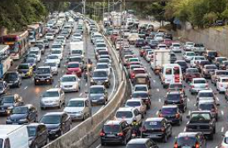

Rival vs Non-Rival Resources
Summary
Rival resources – affected by the use of others eg. fish in the sea
Non-rival – not affected by the use of others eg. sunlight
The terms rival is used to refer to things that people prefer not to share because they are affected by other people
This means that if you use a resource, you will make the resource slightly less useful/valuable/pleasant for another user
  Eg. When you drive on the road, you create more traffic for other drivers
  Therefore, driving on the road is rival.
Non-rival resources are those that are not affected by anyone else’s use.
  One of the best examples of a non-rival resource is sunlight.
    If you experience sunlight it does not affect anyone else, so sunlight is non-rival

Slide 58
See if you can provide more examples of rival goods.
Wifi (if it is a small network)
A crowded beach
Provide more examples of non-rival goods (a bit more difficult)
Food at an all you can eat buffet
Netflix subscription
Looking at a beautiful sunset
A movie in a theatre

Slide 59

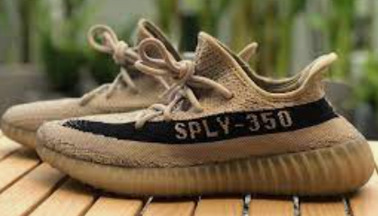




Definition: Goods and Services (G&S)
The resources we have talked about are used to make goods and services.
The difference between the two is simple!
Services are not physically tangible things and so we can’t own them as clearly.
  Eg. A haircut, staying in a hotel, eating at a restaurant, going to the dentist, lawyer representing you, taking a taxi
Goods are physical things that we can purchase and own.
  Eg. Phones, Cars, cups of coffee
Summary:
Resources are used to make goods and services.
Good = physical
Service = not physical

Slide 60
What is the difference between goods and services.
Goods are physical things where as services are not physically tangible.
Note: Often, a firm will offer both goods and services. Eg. Apple sells phones (good) but will repair them (service).

Slide 61


Positive vs Normative Economics
There are two types of statements in Economics (but also other fields).
Summary
Positive – can be proven true or false.
Normative – can’t be proven true or false.
Positive – statements that can be tested with data and hard facts. Note: They can be incorrect!
Can be supported by the use facts, numbers and uses neutral language. Often focuses on ‘cause and effect’ and can be verified through experiments.
Eg. Unemployment has increased by 3%.
  This statement is easily measurable and less open to debate.
Normative – statements based more on opinion and people’s values and beliefs.
Will sometimes contain expressions such as ‘should’, ‘in my opinion’ and more emotional words.
Eg. Improving society’s technology level is more important than the happiness of our citizens.
  This statement is more an opinion because it does not have any clear evidence to support it. Other people may have very different opinions.
Note: Positive has a different meaning in this context. Positive doesn’t mean that these statements are good or nice but rather able to be shown with evidence.

Slide 62
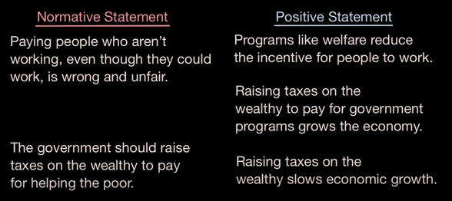
Positive & Normative Economics - YouTube

Slide 63
Activity
Give an example of a positive statement.
  China’s economic growth rate has been one of the highest in the world over the last 50 years.
  Higher education leads to higher salaries in academic fields.
Give an example of a normative statement.
  Economic growth is the most important thing in our society.
  Higher education should be the goal of most people.

Slide 64


Human Wants and Needs
Needs are essential things like food, water, shelter and wants are things beyond this.
Activity: List all the things you want in your life.
What do we notice about this list?
Hint: We know that resources are limited. Do the things we want have a limit also?
Answer: Human wants have no limit. Once we get what we want we usually want more.
Eg. We buy a new house, we want to renovate the kitchen, buy a larger TV, install a pool, buy a comfier couch.
Possible Examples:
A family
Money
Fame
A big house
Fast cars
An iPhone 12 Pro Max
Lots of friends
A girlfriend/boyfriend/wife/husband
To be beautiful
To have many skills
To speak perfect English/Chinese/Spanish etc.
Etc.
Summary
Human wants have no limit.

Slide 65

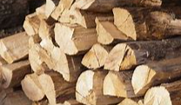


How are our wants and the resources we have connected?
Activity: Choose any human want that you can think of. How do you fulfill this want?
Summary
We must use available resources to fulfill our wants and needs.
Resources and wants are connected because we (try to) use resources to get the things we want.
  Eg. We use wood to build a fire.
  We use our time, electricity, money to watch a movie.
  We study hard at school to get a good job.
  We use our personality to make friends.
Note: Life is unfortunately, very rarely this simple and the ‘devil is in the details’.
production
Output
- that fulfills our wants
Resources
(Inputs)

Slide 66

The Fundamental Economic Problem
Resources – limited/scarce or unlimited/infinite?
Human Wants – limited/scarce or unlimited/infinite?
This is the fundamental economic problem! Our wants are infinite but our resources are scarce.
What is the logical conclusion from this?
Hint: C _ _ _ _ E

Slide 67
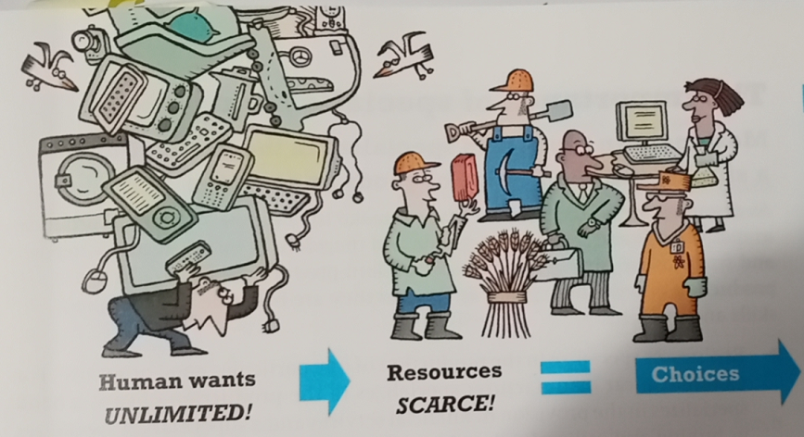
The Fundamental Economic Problem
Humans face huge numbers of choices because we usually don’t have enough resources to get everything that we want!
Examples of Scarce Resources Causing Choice
A business may have to choose between hiring new workers or fixing a broken machine if they don’t have enough money for both!
You have two weeks of holiday. You can’t go to Europe and Africa and the United States because you won’t have enough time, money, energy etc.
Summary:
Scarce resources forces us to make choices.
This is the fundamental economic problem.

Slide 68
Questions
Unlimited
Human wants are limited or unlimited?
Our resources are limited or unlimited?
What is the fundamental economic problem?
Because of this we have make _____________ with how we use our resources.
Limited
We have unlimited wants but limited resources.
choices

Slide 69
Opportunity Cost

Slide 70
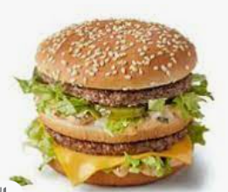
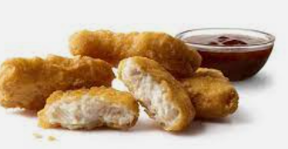
Opportunity Cost
Examples
If you go to McDonalds and order a Big Mac, the opportunity cost is perhaps ordering nuggets which was your next choice.
Where are you right now? What is the opportunity cost?
Answer: You’re at school. You perhaps gave up the satisfaction of staying at home and sleeping!
We have established that the fundamental economic problem is limited resources and unlimited wants, so we have to make choices.
Each time we make one of these choices, we give up the other alternatives.
We often talk about the concept of opportunity cost.
Opportunity cost definition: The value of the next best opportunity or choice foregone.
Summary
Every decision and anything we do has an opportunity cost because we gave up another option.

Slide 71
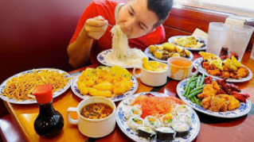

Your boss takes you out for lunch.
He/she pays for everything!
Is there any opportunity cost?
Answer: Yes.
Perhaps the lunch is free, but what about the time you’ve given up? Maybe you could have spent time with your family, read a book or gone to the gym. In this case, time is the main cost.

Slide 72
Give some examples of opportunity cost.
You decide to go to university. Opportunity cost is getting a job.
You marry Jackie. The opportunity cost is marrying Mary.
You get a job which pays a lot but is boring. Opportunity cost is a job that pays less but is interesting.

Slide 73
Note: Giving up benefits and giving up disadvantages
We assume, when we talk about opportunity cost that we are talking about the benefits that we are giving up.
If we are giving up something negative, that is not opportunity cost.
Eg. You choose to work at company A instead of your old job, company B. Company B was far from your home.
  Even though Company B is the opportunity cost of working at company A, giving up the long commute is not really an opportunity cost because you’re giving up a negative thing.

Slide 74





Trade-offs vs Opportunity Cost
Tradeoff examples:
There is a tradeoff between buying expensive clothes and buying other things.
There is a tradeoff between cooking your own food and saving money and eating takeaway food and saving time.
  Trade-off – The idea of tradeoffs is more general and used in everyday speech. It is the conflict between two or more things
  Eg. There is a tradeoff between working fast and making mistakes.
Opportunity Cost – the next best opportunity foregone (the second best opportunity that you gave up)
Because of the fundamental economic problem of scarcity, the idea of tradeoffs is a big part of what economics is about!
Summary
Tradeoff and opportunity cost are similar ideas.
Tradeoff – the conflict between two choices.
Opportunity cost – next best opportunity given up.

Slide 75
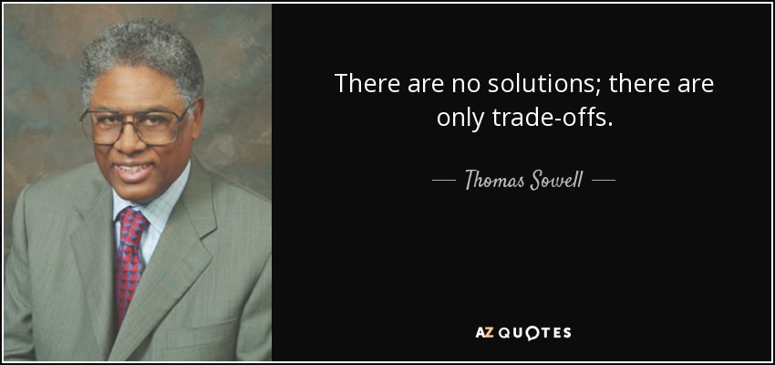
This is a great quote that illustrates the fundamental economic problem!

Slide 76
What is the definition opportunity cost?
When we make a choice, the opportunity cost is the next best opportunity foregone ie. The second best choice we would have made.
Give an example of opportunity cost (it can be in a business context or a personal, everyday example).
You choose to study in the United States. Your opportunity cost is studying in Canada.

Slide 77
The PPC

Slide 78
Learning Objectives Checklist
Inefficient, Efficient and Unattainable Production
Graphically Showing Opportunity Cost
Shifts of the PPC
Increasing vs Constant Opportunity Cost

Slide 79
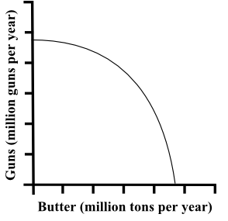
The PPC
Alternate Names:
opportunity cost curve
production possibility boundary (PPB)
production possibility frontier (PPF)
Summary
The PPC shows all the different possibilities of production.
A beneficial way to illustrate the concept of opportunity cost and tradeoffs is through the production possibility curve (PPC).
What is it? The PPC demonstrates the maximum possible combination of output produced, given the available resources and technology, within a specific country.
The PPC is based on the assumption that the country produces only two goods (i.e., for purposes of simplification). The boundary of the PPC is the connecting line between various output combinations.
The line shows the different bundles of production of two different goods.

Slide 80
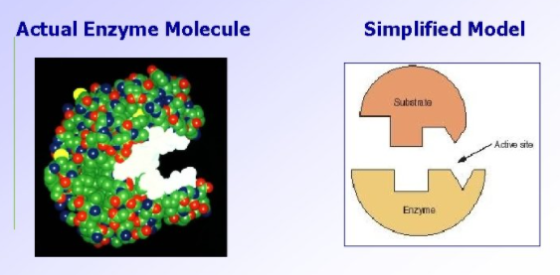

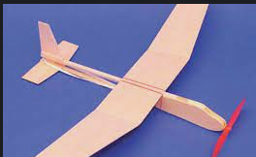
Why only two goods?
We simplify the economy to be producing just two goods when in actual fact there are millions of different goods/services.
Why? It makes analysis a lot simpler.
Even if we added more goods we would not gain any additional insights because we can show the concept of opportunity cost and tradeoffs with only two goods.
Economics is famous for overly simplified models but we see this in many different fields!

Slide 81
What does the PPC show?
The maximum amount of output of two goods.
Why does the model only show two goods when an economy produces millions of different goods?
It is far easier to show graphically
With only two goods we can still show a lot as we will soon see.

Slide 82
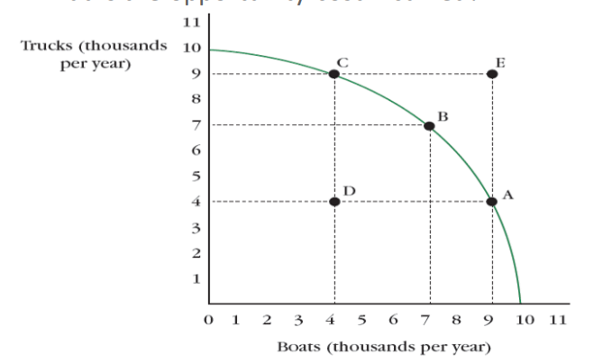
Efficient
Efficient – on the PPC
  At this point all resources are being fully utilized.
Inefficient – inside the PPC
  Not all resources are being utilized.
Unattainable – outside the PPC
  Production that cannot be achieved because there are insufficient resources ie. factors of production
    Eg. Machines, labor, land, technology etc.
Unattainable
Efficient
Inefficient
Efficient

Slide 83
Points on the PPC
Note:
We are referring to productive efficiency in this case!
Because we are producing at the lowest possible cost.
However, this doesn’t tell us if we are producing things that are best for society (allocative efficiency)
Efficient – on the PPC
  At this point all resources are being fully utilized.
Inefficient – inside the PPC
  Not all resources are being utilized.
Unattainable – outside the PPC
  Production that cannot be achieved because there are insufficient resources ie. factors of production
    Eg. Machines, labor, land, technology etc.

Slide 84
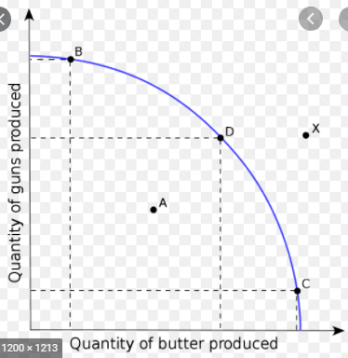
Activity
Production Possibilities Curve
What does PPC stand for? Ie. PPC = P________ P_________ C______
Draw a PPC.
Label points that are: Inefficient, Efficient, Unattainable
Efficient
Unattainable
Inefficient

Slide 85
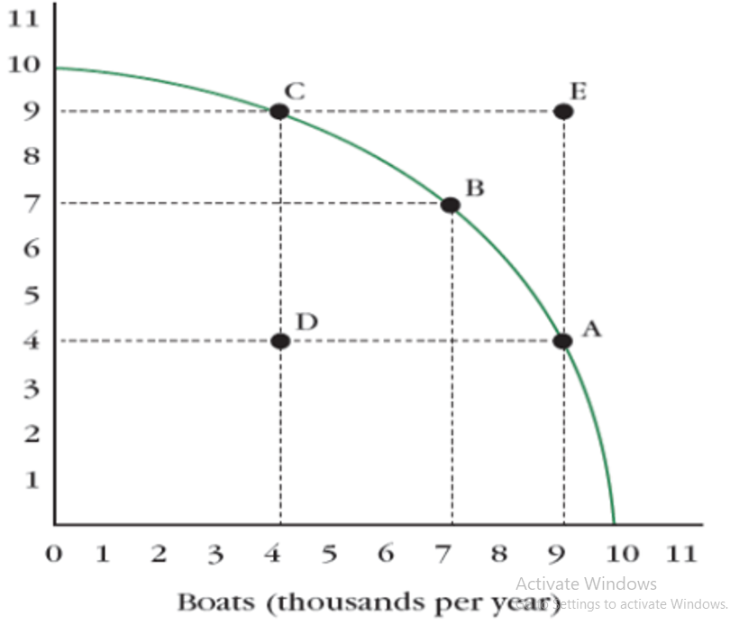
The PPC shows opportunity cost
Summary
Increase one good = produce less of another (when we are ON the PPC)
This is opportunity cost.
In life we see so many examples of tradeoffs.
The PPC shows how tradeoffs naturally occur.
When we are producing efficiently, in order to increase the output of Good A, we must decrease the output of Good B. So this shows an opportunity cost!
Trucks
(1000 per year)
If we move from point C to point B:
When we are efficient: Increasing trucks = decreasing boats.
There is an opportunity cost of producing more boats is what we gave up in trucks:
OC = 2000 trucks / 3000 boats = 0.7 trucks per 1 boat
As an approximation (because the graph is actually curved)

Slide 86
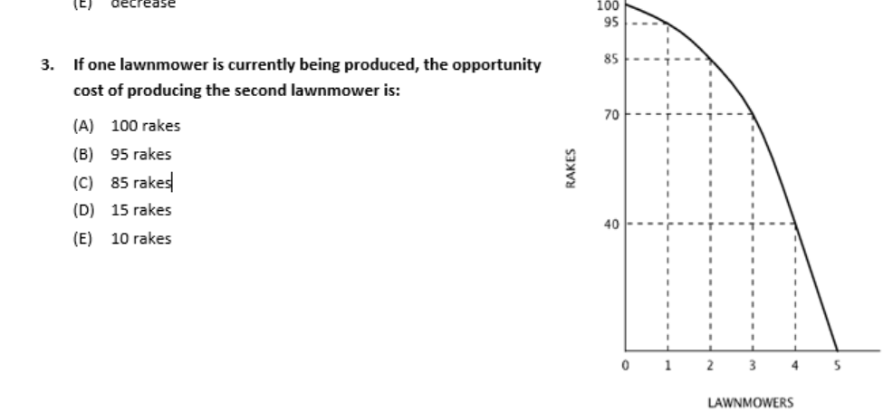
Opportunity Cost =
What you give up / what you gain
Answer:
To make one more lawnmower you produce only 85 rakes, from 95. Therefore O.C. is 10.

Slide 87
Pareto Improvement (no O.C.)
Bonus
What if we move from point D to point B?
  Is there a tradeoff?
  Do we have to give up any trucks or boats?
  No! Noone is made worse off.
  This situation is called a Pareto improvement because there is no tradeoff in producing more.
The same is true of a move from B to E (assuming we can move there, which is not attainable)
Trucks
(1000 per year)
Summary
When we are inefficient we CAN increase more of both goods.
When we increase both, this is called a Pareto improvement.
We have increased production of boats and trucks! A Pareto improvement.

Slide 88
What is a Pareto improvement? Draw this on a PPC.
An improvement that benefits all people (or at least doesn’t make anyone worse)
This can be shown by a move from D to C, D to B, D to A, D to E.
Trucks
(1000 per year)

Slide 89
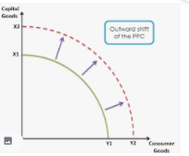

Shifts of the PPC
  J Clifford
In economics we shift curves a lot!
If the PPC shifts outward, we can produce more of all goods and potentially have a Pareto improvement.
What could cause the PPC to shift outwards
  Change in quantity or quality of resources
  Change in technology

Slide 90


Shifts of the PPC
  J Clifford
In economics we shift curves a lot!
If the PPC shifts outward, we can produce more of all goods and potentially have a Pareto improvement.
What could cause the PPC to shift outwards
  Change in quantity or quality of resources
  Change in technology
Summary
A change in the quality or quantity of the factors of production/resources will shift the PPC outwards.

Slide 91
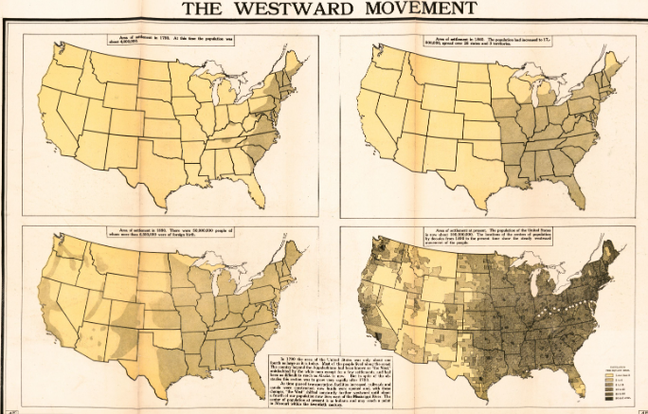
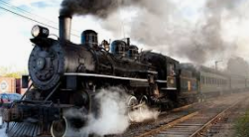
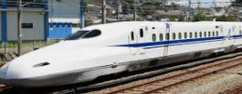
Outward shift of the PPC Examples
Increase in Land
Note: This is one representation of economic growth, which is looked at several times in AP Macro.
Technology Increase
Faster trains allow for faster and cheaper movement of goods/services, people and ideas.
This means that we can produce more of most goods.
The US was originally a small number of colonies. However as people moved west, the US claimed more and more land. This pushed out their PPC as they had more land to help them produce more of a wide variety of goods.

Slide 92



Inward Shift of the PPC
A country that suffers from war or natural disaster that damages and destroys resources would see an inward shift of the PPC.
Any other factors that reduce the ability to produce such as:
  Corruption
  Loss of skilled and talented individuals (moving to other countries)
    Eg. Ireland’s population fell from 6.5 million to 2.8 million as many people moved to the United States seeking a better life in the late 1800s and early 1900s
Summary
An inward shift of the PPC could be caused by a decrease in resources or technology.

Slide 93
What effect does an increase in capital goods in the economy have on the PPC.
It will shift out the PPC because capital goods increase our ability to produce goods.

Slide 94

4. Assume a country produces two goods: bikes and cars. Draw a PPC and label it showing: a) Efficient allocation of resources.

Slide 95

b) There is a huge increase in the unemployment level
Ie. Inefficient allocation of resources
Note: Nothing has happened to the people, they’re still alive and have their skills. They are just not being fully utilized.
If there was a war that killed people, then the PPC would shift inward.

Slide 96

c) Unattainable production.

Slide 97

d) Now assume that the country discovered new resources. Show the effect of this discovery on your PPC graph
Unless stated otherwise, assume that this means that all production will benefit.

Slide 98

e) Show the effect of improvements in technology of car production but this technology has no effect on bike production.

Slide 99
The PPC – Crash Course Economics
https://youtu.be/NI9TLDIPVcs?t=233

Slide 100


The Law of Increasing Opportunity Cost
Why is the PPC bow shaped?
Sometimes it’s drawn with a curve, sometimes it’s straight. What’s the difference?
This can be explained by the law of increasing opportunity cost.
In short: Not all resources are equally adapted to other uses.
Summary
The PPC is shaped like a bow when there is increasing opportunity cost.

Slide 101




Not all Resources are Equal!
Our resources: land, labor, capital and enterprise all vary hugely.
Some resources are better at producing things than others.
The most efficient way is to use resources to produce the things they are most suited for.
Some parts of the world have land and climates that can grow oranges very well.
Examples
Land – some land is better at growing different crops.
Labor – People often have strengths and weaknesses.
Eg. A computer scientist should work with computers and not be an actor.
Capital – Equipment is designed for specific uses.
Eg. A chainsaw should be used for cutting trees and not making laptops.
Enterprise – Someone who is an expert in cars might not be suited to starting a restaurant.
Some parts of the world will have land suited to growing coffee beans.
Summary
Some resources are good at making some things but not good at making other things.

Slide 102

Increasing Opportunity Cost Example
Eg. Land is not equally appropriate for all crops.
You have five pieces of land which have ratings for how well they can grow crops:
  Land 1: coffee – 5 stars, oranges – 1 star (You use this to grow coffee)
  Land 2: coffee – 4 stars, oranges – 2 star Land 2 – 5 you grow oranges!
  Land 3: coffee – 3 stars, oranges – 3 star
  Land 4: coffee – 2 stars, oranges – 4 star
  Land 5: coffee – 1 stars, oranges – 5 star
Coffee generally grows in high altitudes.
One day you decide you want to grow more coffee.
  You convert Land 2 which is the best available land at growing coffee which means you give up x oranges.
Afterwards you decide to grow even more coffee.
  You choose Land 3 which is not as good as land 2 at growing coffee and as a result you give up more oranges for less coffee.
Afterwards you decide to grow even more coffee.
  The best remaining land is land 4 which is pretty bad at growing coffee but was pretty good at growing oranges.
    You give up a lot of oranges to grow not much coffee.
Summary:
As you grow more coffee the land is less and less suitable for coffee so you give up more and more to grow the coffee.
We can see that we are progressively giving up more oranges to grow less coffee. So our opportunity cost is increasing!

Slide 103

Opportunity Cost
Coffee
We can see that as we use worse and worse land you will give up 10 oranges but get less and less coffee.
Ie. increasing opportunity cost (O.C.)
Remember: the OTHER good is the numerator when we calculate O.C.
D
OC = 10/1.5
1.5
C
OC = 10/4
4
B
OC = 10/8
8
Opportunity Cost =
What you give up / what you gain
A
Eg. you give up 10 oranges and gain 8 coffee
OC = 5/4
Summary
If we continue the example of coffee and oranges, we can see increasing opportunity cost – a curved PPC.
10
10
10
Orange

Slide 104

Which one is more realistic?
Increasing Opportunity cost
Summary
Straight = constant O.C.
Curved = increasing O.C.
Revision Link
  When you use land that is good for pineapples to grow cactus, you’ll give up lots of pineapples and grow only a few extra cactus.
Constant opportunity cost
  Resources are equally suited for all production
    EASILY ADAPTABLE
Increasing opportunity cost
  Resources are NOT equally suited for all production
    NOT EASILY ADAPTABLE

Slide 105
Activity
Why is the PPC often curved? Give an example why.
Because of increasing opportunity cost which is caused by the fact that resources are not equally good at producing different products.
Eg. If a pizza chef is forced to make computers they may produce only a few computers and give up many pizzas, so the opportunity cost will be very high.

Slide 106
clothes | 140 | 120 | 90 | 50 | 0
cars | 0 | 10 | 20 | 30 | 40
Based on this information, is the PPC increasing or constant opportunity cost?
Increasing, because for example as we increase cars, we give up more and more clothes.
What shape would the PPC be based on your previous answer?
It would be curved (compared to straight for a constant opportunity cost PPC)

Slide 107
Core Concepts
  PPC
    Opportunity Cost
    Efficiency
    Law of Increasing Opportunity Cost
    Shifters of PPC
    Capital Goods and Future Growth

Slide 108
Trade & Comparative Advantage

Slide 109
Learning Objectives Checklist
Representing PPCs as Production Tables
Absolute Advantage
Comparative Advantage
  Calculating Opportunity Cost
Gains from Trade
Output vs Input Questions
  Difference for Absolute Advantage
  Difference for Comparative Advantage
Terms of Trade

Slide 110


What is trade?
Trade can be seen as the exchange of goods and services between different groups of people/locations.
Trade is a huge part of human behavior and can be traced back to the earliest humans and present day.
An important question to ask is: Who produces what?
Eg. Why does China produce manufactured goods and Australia produces beef?
The ancient silk road and current plans by China to expand international trade.
Summary
Trade is about different countries producing different things and buying and selling them.

Slide 111

Production Tables vs PPC
Summary
We can show the maximum production of a PPC in a table.
Wine
Country | Output Wine | Output Cheese
Australia | 3 | 3
France | 5 | 7
Cheese
We can represent the PPC in a table that shows the maximum output of both goods.
Note: Fortunately, in the problems that we will look at, we assume constant opportunity cost so that the lines are straight and the maths is much easier!

Slide 112


Two Types of Advantage (in production)
Absolute advantage – More can be produced in total
Comparative Advantage – Having the lower opportunity cost (ie. giving up less units of the other good)
A country can have absolute advantage in producing a good but also a comparative advantage.
We will look at the difference between the two.

Slide 113


Absolute Advantage
This results from a country either having:
  Greater efficiency using the same amount of resources
    Eg. An equally sized piece of land can produce 5 bags of rice vs 3 bags of rice.
  OR
  2. Greater ability to produce overall by simply having more resources
    (this is the most commonly examined)
    Eg. A country has more land and can produce more rice than another country.
India is a large producer of tea as it has a large population and large amounts of land.
It will have an absolute advantage in tea production over most countries even if its production methods are not super efficient!
Summary
Absolute advantage has two definitions:
Can produce more.
Can produce more using the same resources.

Slide 114
Showing Absolute Advantage
Summary
We can see the absolute advantage by ‘choosing the larger number’ in the table or on the PPC.
Wine
Country | Output Wine | Output Cheese
Australia | 3 | 3
France | 5 | 7
Cheese
Which country has absolute advantage?
Answer: France is able to produce more of both goods.
  It therefore has an absolute advantage in both wine and cheese.
Based on our definition of absolute advantage we can use the table or look at the PPC graph to find out which country has absolute advantage in the production of these goods.
  The country which can produce a higher number has absolute advantage.

Slide 115
What determines if a country has absolute advantage over another country?
If they can produce more of a good OR more of a good using the same resources.
Draw a production table which shows this.
India has absolute advantage in tea and clothes.
Country | Output Tea | Output Clothes
Malaysia | 3 | 3
India | 5 | 7

Slide 116

Comparative Advantage
Definition
Comparative advantage is the basis for all trade between individuals, regions and nations (which is why David Ricardo’s theory is considered one of the great economic theories).
Comparative advantage is the ability of a firm or individual or country to produce goods and/or services at a lower opportunity cost than other firms or individuals.
  Logically this makes sense because lower cost is almost always a good thing!
Summary
A country has comparative advantage if its opportunity cost of production is lower.

Slide 117


David Ricardo and Comparative Advantage
Summary
David Ricardo came up with the idea of comparative advantage which is more important than absolute advantage.
This was a groundbreaking theory because it changed how we look at countries and what they should produce and what they should trade.

Slide 118

Revision
Revision
Trucks
(1000 per year)
Opportunity Cost =
What you give up / what you gain
Summary
When a country makes Good A then we are giving up producing Good B. This is the opportunity cost!

Slide 119
Calculating Opportunity Cost
Summary
The OC of each good is found by dividing ‘the other good’ by the one you are looking at. Ie. What you give up/what you get
Country | Output Wine | Output Cheese
Australia | 3 | 3
France | 5 | 7
Wine
OC = 7/5
OC = 5/7
Cheese
For Wine
When France uses all its resources to produce 5 wine, it gives up 7 Cheese.
Therefore the Opportunity Cost (OC) of 1 Wine = 7 cheese / 5 wine
Therefore 1 wine costs 1.3 cheese to produce
Note: We can do this because the lines are straight, if they were curved the OC would vary)
For Cheese
It will always be the opposite of the other good that you already calculated.
Therefore the OC = 5/7
1 Cheese costs 5/7 wine to produce.
Opportunity Cost =
What you give up / what you gain

Slide 120
Using the OC to find Comparative Advantage.
Summary
Choose the lower opportunity cost for each good to find the comparative advantage.
Wine
Country | Output Wine | Output Cheese
Australia | 3 | 3
France | 5 | 7
OC = 3/3 = 1
OC = 3/3 = 1
OC = 7/5
OC = 5/7
Cheese
So, which country has comparative advantage in Wine?
Answer: Australia has the lower opportunity cost (1 < 7/5) and therefore comparative advantage in wine
Which country has comparative advantage in Cheese?
Answer: France has the lower opportunity cost (5/7 < 1) and therefore comparative advantage in cheese
Note: In these questions:
Absolute advantage can sometimes be the same country for both goods.
Comparative advantage is always 1 country is 1 and another country is the other.

Slide 121
Country | Output Wine | Output Cheese
Australia | 4 | 2
France | 8 | 9
Calculate the opportunity costs for the following table.
Who has comparative advantage in each good?
  Wine = Australia because ½ < 9/8
  Cheese = France because 8/9 < 2
Country | Wine | Cheese
Australia | 2/4 = 1/2 | 4/2 = 2
France | 9/8 | 8/9

Slide 122
Country | Cars | Phones
USA | 10 | 15
Germany | 12 | 10
Calculate the opportunity costs for the following table.
Who has comparative advantage in each good?
  Germany: Cars
  USA: Phones
Country | Cars | Phones
USA | 15/10 = 3/2 | 10/15 = 2/3
Germany | 10/12=5/6 | 12/10 = 6/5

Slide 123
Country | Bread | Milk
Italy | 8 | 6
Canada | 7 | 9
Calculate the opportunity costs for the following table.
Who has comparative advantage in each good?
  Italy: Bread
  Canada: Milk
Country | Bread | Milk
Italy | 6/8 | 8/6
Canada | 9/7 | 7/9

Slide 124

What should we learn from comparative advantage?
In our simplified questions, we will see the countries should actually specialize in producing just one good. Then they should sell this good to other countries.
Summary
Comparative advantage tells us which countries should specialize in producing which goods.

Slide 125

Comparative Advantage Summary
David Ricardo came up with the idea of comparative advantage which means a country has a lower OC of production.
(Absolute advantage means that a country can either: produce more or produce more using the same resources.)
If a country has comparative advantage they should specialize in that good.
  They should export this good.
  They should import goods that they do not have comparative advantage in.
Summary
Comparative advantage determines which countries produce which goods.

Slide 126


Slide 127


Gains from Trade
Trade can help both countries to consume beyond their PPC – in this case we see a Pareto improvement!
With trade, both countries can reach a point that was previously outside of their PPC and unattainable.
Trade allows us to consume beyond our PPC.
Ie. point D
Country A
With trade we can move to point D without increasing technology or resources!
Comparative Advantage Gains from Trade
Summary
When countries specialize according to comparative advantage and trade, this benefits both countries.

Slide 128



Before Specializing
After Specializing
By specializing according to comparative advantage and then trading, both Bob and the woman can consume beyond their PPC at point D.

Slide 129


Gains From Trade
By specializing according to comparative advantage and then trading, both Bob and the woman can consume beyond their PPC at point D even though they can only produce on their PPC.
This is because, by specializing according to comparative advantage, the costs of production have fallen, which creates the same effect as if technology or resources had improved.
Note, there would be more factors at play to work out how exactly the total production would be divided between Anne and Frank but this is beyond the scope of the course.
Before Specializing
After Specializing
Summary
With trade, we can only produce on our PPC but we can consume outside of our PPC. This is the magic of trade!
Anne
Production with trade = 10 Bananas, 0 Fish
Frank
Bananas
Bananas
Consumption after trade = 20 Fish, 5 Bananas
Consumption after trade = 10 Fish, 5 Bananas
(Consumption before trade = = Production = 15 Fish, 5 Bananas)
(Consumption before trade = Production = 5 Fish, 5 Bananas)
Production with trade = 30 Fish, 0 Bananas
Fish
Fish

Slide 130

A Video Demonstrating Comparative Advantage
Comparative advantage is all about the lowest opportunity cost.
  When we produce 1 unit of Good A eg. bananas, we think about how much we could have produced of Good B in that time.
  If we produce 1 banana, we want to give up less fish. This means a lower opportunity cost.
So let’s look at a video that illustrates this concept.
Short video

Slide 131
Does trade help us produce beyond our PPC?
No, because our resources are unchanged.
Does trade help us consume beyond our PPC?
Yes, because by specializing we are more efficient. This is the ’magic of trade’.

Slide 132
What is meant by the expression ‘gains from trade’?
Gains from trade means that there is potential for benefits to both countries. (This is called a Pareto improvement.)
Graphically this is shown by the countries consuming beyond their PPC at point D!
What does comparative advantage have to do with ‘gains from trade’?
Comparative advantage is how we decide which countries should produce which goods.
If we follow the rule of comparative advantage this increases efficiency so we produce more goods overall.

Slide 133

Bonus: What happens to societies that do not trade?
This has happened in history before to the indigenous people of Tasmania when the sea level increased, leaving the people isolated.
When they were discovered by Europeans, their society had regressed to a stone age level where they barely had basic tools.
Technology had actually gone backwards!
This happened for many reasons but one reason was because they lost the ability to trade (they did not have ships) which lead to lower efficiency of production.
Comparative Advantage - YouTube
“Self sufficiency is inefficiency and inefficiency can lead to poverty.”
Summary
Groups of people that can’t or don’t trade are often much poorer and technologically backward because of lower production efficiency.

Slide 134
Summary: Comparative Advantage
Another example
 | Good A | Good B
Country A | 5 (OC = 3/5) | 3(OC = 5/3)
Country B | 7(OC = 7/7) | 7(OC = 7/7)
Absolute advantage – How much can be produced in total
Country B has absolute advantage in both goods.
Comparative Advantage – Having the lower opportunity cost (ie. giving up less units of the other good)
Country A: comparative advantage in Good A.
Country B: Comparative advantage in good B.
The country should make the good they have comparative advantage in and export it. They should import the other good.
Gains From Trade
When countries specialize according to comparative advantage, countries can produce on the same PPC but consume beyond their PPC.

Slide 135








Output Questions vs Input Questions
Output Questions
This is the standard type of question. It will talk about the quantity of the goods produced for both country.
Eg. Country A produces shoes and guns.
Shoes and guns are output!
Input Questions
This is the slightly tricky question type.
It will talk about the things used to make goods.
Things you may see in input questions:
  Hours/time
  No. of workers
  No. of machines
  Amount of gasoline used etc.

Slide 136
Nation Alpha can produce either 3 units of good X or 1 unit of good Y with one hour of labor, whereas nation Beta can produce either 4 units of good X or 2 units of good Y with one hour of labor. Assuming that labor is the only input, which of the following is true?
Is this an input question or output question?
Output question. Even though it mentions hours of labor, the numbers are in terms of units of output.

Slide 137
Input Question Tables
Output Question
Input questions may have the same numbers but they have a different meaning!
They show how many resources are being used.
Generally we want to use FEWER resources when we produce.
Country | wine | cheese
Aus | 4 | 4
Fra | 5 | 3
We choose the bigger number.
Input Question
Country | Inputs to make wine | Inputs to make cheese
Aus | 4 hrs | 4 hrs
Fra | 5 hrs | 3 hrs
Summary
Input question tables show how many resources are being used.

Slide 138
Absolute Advantage in Input Questions
Output Question
Usually we choose the bigger number for absolute advantage.
However, when we have an input question we must choose the smaller number!
Even if the numbers are the same, we must do the opposite for an input question compared to an output question.
Country | wine | cheese
Aus | 4 | 4
Fra | 5 | 3
We choose the bigger number.
Australia has absolute advantage in cheese. France has absolute advantage in wine.
Input Question
Country | Inputs to make wine | Inputs to make cheese
Aus | 4 hrs | 4 hrs
Fra | 5 hrs | 3 hrs
We choose the smaller number.
Summary
For absolute advantage:
Output question – choose the bigger number.
Input question – choose the smaller number.
Australia has absolute advantage in wine. France has absolute advantage in cheese.

Slide 139
When we represent country production in terms of inputs do countries want to have bigger or smaller numbers?
Smaller! Countries want to use fewer resources/less inputs.
Use the following table, which country has absolute advantage in butter?
France
Country | Machine hrs to make guns | Machine hrs to make butter
Aus | 5 | 4
Fra | 7 | 3

Slide 140
Solving Comparative Advantage Question in terms of Inputs
Country | Inputs to make wine | Inputs to make cheese
Aus | 4 hrs | 4 hrs
Fra | 5 hrs | 3 hrs
Method 1: Convert to Output then solve normally
Prestep: Convert the numbers to output by dividing each number by reversing the number! Eg. 4 becomes 1/4. Then you can multiply to make the number more convenient.
  OR you can just have the same numerator, eg. 4, and divide every number by 4.
Now that the table is in terms of output you can perform the same steps as usual – find the OC (given up/gained) and choose the smaller OC for comparative advantage.
1/4/1/4 = 1
1/4/1/4 = 1
¼ units
¼ units
1/5 units
1/3 units
1/3 / 1/5 = 5/3
1/5 / 1/3 = 3/5
Using Method 1:
1 Prestep (red)
2 Opportunity Cost (purple)
3 Lowest opportunity cost
4 Comparative Advantage
Cheese: France , Wine: Australia
Summary
We can convert the input numbers into outputs by using them to divide the same number. Then we can find the OCs the same way.

Slide 141
Solving Comparative Advantage Question in terms of Inputs
Country | Inputs to make wine | Inputs to make cheese
Aus | 4 hrs | 4 hrs
Fra | 5 hrs | 3 hrs
Method 2: Reverse the OC calculation (faster)
Reverse the OC calculation (so that instead of ‘the other good’ being the numerator, it is now the denominator
Choose the smallest numbers as usual
1/1 = 1
1/1 = 1
5/3
3/5
Using Method 2:
1 Prestep (red)
2 Opportunity Cost (purple)
3 Lowest opportunity cost
4 Comparative Advantage
Cheese: France , Wine: Australia
Note: Regardless of which method we choose, the answer should be the same. Of course, method 2 is much faster but method 1 is more logical.
Summary
We can directly find the OCs by reversing the usual OC calculation.

Slide 142
Solving Comparative Advantage Question in terms of Inputs
Country | Inputs to make wine | Inputs to make cheese
Aus | 4 hrs | 4 hrs
Fra | 5 hrs | 3 hrs
Method 1: Convert to Output then solve normally
Prestep: Convert the numbers to output by reversing the numerator and denominator of the number eg. 4 -> 1/4
Now that the table is in terms of output you can perform the same steps as usual – find the OC (given up/gained) and choose the smaller OC for comparative advantage.
1/1 = 1
1/1 = 1
5/3
3/5
Method 2: Reverse the OC calculation (faster)
Reverse the OC calculation (so that instead of ‘the other good’ being the numerator, it is now the denominator
Choose the smallest numbers as usual
Note: Regardless of which method we choose, the answer should be the same. Of course, method 2 is much faster but method 1 is more logical.
Summary
For Input Questions we have to change how we calculate the OCs. However we arrive at the same answer with both methods.

Slide 143
How do we complete a comparative advantage question differently when it is in terms of inputs (and not outputs)?
The OC calculation is reversed!
We can: a) convert the inputs to output first and then solve as normal (method 1)
OR
B) we can directly reverse the opportunity cost calculation (method 2).

Slide 144
Country | Machine hrs to make guns | Machine hrs to make butter
Aus | 5 | 4
Fra | 7 | 3
Use the production table to calculate which country has comparative advantage in which good.
Australia OC_{guns} = 5/4, OC_{guns} = 4/5
France OC_{guns} = 7/3, OC_{guns} = 3/7
Comparative Advantage: Guns – Australia, Butter - France

Slide 145
Country | Brazil | Argentina
Soybeans | 50 mins | 45 mins
Corn | 40 mins | 55 mins
Use the production table to calculate which country has comparative advantage in which good.
Brazil OC_{soybeans} = 50/40, OC_{corn} = 40/50
Argentina OC_{soybeans} = 45/55, OC_{corn} = 55/45
Comparative Advantage: Soybeans – Argentina, Corn - Brazil

Slide 146
Comparative Advantage in Input Questions Comparison
Output Question
For comparative advantage, as we showed, the OC calculation is the opposite.
Therefore even though the numbers in this question are the same, the OC values will be inverse.
Therefore the comparative advantage countries will also be the inverse.
  In this example Australia has comparative advantage in cheese for the output question BUT comparative advantage in wine in the input question.
Country | wine | cheese
Aus | 4 | 4
Fra | 5 | 3
4/4 = 1
4/4 = 1
3/5
5/3
Australia has comparative advantage in cheese. France has comparative advantage in wine.
Input Question
Country | Inputs to make wine | Inputs to make cheese
Aus | 4 hrs | 4 hrs
Fra | 5 hrs | 3 hrs
4/4 = 1
4/4 = 1
Summary
Compared to an output question, the OC values and the comparative advantage countries will be the inverse.
5/3
3/5
Australia has comparative advantage in wine. France has comparative advantage in cheese.

Slide 147
Output Question
Abs Advantage: China for both
Comparative Advantage: China: Wood, South Korea: Steel
Country | Wood | Steel
China | 1/1 | 1/1
South Korea | 8/2 | 2/8
Country | Wood | Steel
China | 10 | 10
South Korea | 2 | 8
Input Question
Abs Advantage: Korea for both
Comparative Advantage: China: Steel, South Korea: Wood
Country | Wood | Steel
China | 1/1 | 1/1
South Korea | 2/8 | 8/2
Using the numbers from the table, find the absolute and comparative advantage for both countries, first for an output question and then for an input question.

Slide 148
Output Question
Abs Advantage: India for tea, Colombia for Coffee
Comparative Advantage: India for Tea, Colombia for coffee
Country | Tea | Coffee
India | 4/9 | 9/4
Colombia | 12/3 = 4 | 1/4
Country | Tea | Coffee
India | 9 | 4
Colombia | 3 | 12
Input Question
Abs Advantage: Colombia for tea, India for Coffee
Comparative Advantage: India for coffee, Colombia for tea
Country | Tea | Coffee
India | 9/4 | 4/9
Colombia | 3/12 = 1/4 | 4
Using the numbers from the table, find the absolute and comparative advantage for both countries, first for an output question and then for an input question.

Slide 149




Terms of Trade
We have already talked about how comparative advantage can help us make gains from trade.
  However, gains from trade can only happen when the prices are not too imbalanced!
Mathematically we can define the terms of trade. Ie. the prices that are acceptable for each country.
  There is a range of prices that will benefit both the seller and the buyer of the good.
  Remember, that we have now calculated who produces what based on the comparative advantage.
If the price is too high, the buyer won’t be happy.
If the price is too low, the seller won’t be happy.
At the right price, both the buyer AND seller will be happy.
Summary
Terms of trade is the price that allows for gains from trade and makes buyers and sellers happy.

Slide 150

Terms of Trade Calculation
 | Capital Goods | Consumer Goods
Pakistan | OC = 2/3 | OC=3/2
Uzbekistan | OC = 1/4 | OC = 4/1
Suppose we have already calculated the OCs and determined the comparative advantage. Uzbekistan is making the capital goods in this case and therefore is the seller and Pakistan is the buyer.
From Uzbekistan (Seller)’s perspective:
  The cost of production is ¼ (of a consumer good) so they will be happy to sell for more than ¼.
From Pakistan (Buyer)’s perspective:
  They currently pay 2/3 if they make the goods themselves in their own country. So they will want to buy for less than 2/3.
Note:
because we don’t have $, all prices are expressed in terms of the OTHER good. Ie. 1 capital good costs 2/3 consumer good
In defining the terms of trade equation, put the seller on the left, and 1 of whichever good in the middle
So, any price in between these two prices will benefit both buyer and seller.
  Therefore ¼ consumer good < 1 capital good < 2/3 consumer good
The range of acceptable prices is just between the lowest and highest OC of that good.

Slide 151
Terms of Trade Calculation
 | Capital Goods | Consumer Goods
Pakistan | OC = 2/3 | OC=3/2
Uzbekistan | OC = 1/4 | OC = 4/1
Suppose we have already calculated the OCs and determined the comparative advantage. Uzbekistan is making the capital goods in this case and therefore is the seller and Pakistan is the buyer.
From Uzbekistan (Seller)’s perspective:
  The cost of production is ¼ (of a consumer good) so they will be happy to sell for more than ¼.
From Pakistan (Buyer)’s perspective:
  They currently pay 2/3 if they make the goods themselves in their own country. So they will want to buy for less than 2/3.
We can use the same logic to give the answer in terms of consumer goods!
Pakistan wants to sell for a higher price than 3/2 and Uzbekistan wants to buy for less than their cost of 4/1.
Summary
The range of acceptable prices is just between the lowest and highest OC of that good.
So, any price in between these two prices will benefit both buyer and seller.
  Therefore ¼ consumer good < 1 capital good < 2/3 consumer good
Note: Both answers are equivalent but in different forms!
Therefore 3/2 capital goods < 1 consumer good < 4/1 capital good

Slide 152
Country | Wine | Cheese
Denmark | OC = 1/2 | OC = 2
Sweden | OC = 4/3 | OC = 3/4
Calculate the terms of trade based off the table.
You can answer two ways:
1 wine = between ½ and 4/3 cheese
OR
1 cheese = between ¾ and 2 wine

Slide 153
Full Comparative Advantage Questions
Country | Output Wine | Output Cheese
Australia | 3 | 4
France | 5 | 5
1. Determine Absolute Advantage
  Bigger number for output questions
  Smaller number for input questions
2. Calculate Comparative Advantage
  1. Find the opportunity costs
    “What you give up” / “What you gain”
    The ‘other good’ / the good you are calculating the OC for
    Opposite for input questions
  2. Circle the lowest opportunity costs for each good – the country with the lower OC has comparative advantage. The country will export this good and import the other good.
  Note: It will always be a diagonal!
3. Find the terms of trade that allow for gains from trade
  It will be any price between the lowest and highest price/OC for each good.
4 cheese /3 wine = 4/3
3 wine /4 cheese = 3/4
5 cheese /5 wine = 1
5 wine /5 cheese = 1
Terms of trade:
For Wine: between 1 cheese and 4/3 cheese
ie. 1 cheese< 1 wine < 4/3 cheese
For Cheese: between 3/4 wine and 1 wine
3/4 wine< 1 cheese < 1 wine
Summary
We have now covered all the steps to solve production table trade questions. Most questions typically won’t involve all these steps.

Slide 154
Country | Poland | Germany
Wheat | 3 | 4
Beer | 2 | 6
Find absolute advantage, comparative advantage and the terms of trade that allow for gains from trade.
Country | Poland | Germany
Wheat | 2/3 | 6/4=3/2
Beer | 3/2 | 4/6=2/3
Germany has absolute advantage in both.
Germany has comparative advantage in beer.
Poland has comparative advantage in wheat.
The acceptable price range for wheat: 2/3 beer < 1 wheat < 3/2 beer
The acceptable price range for beer: 2/3 wheat < 1 beer < 3/2 wheat

Slide 155
Country | Oil | Cocoa
Ghana | 15 workers | 5 workers
UK | 4 workers | 10 workers
Find absolute advantage, comparative advantage and the terms of trade that allow for gains from trade.
Country | Oil | Cocoa
Ghana | 15/5 = 3 | 5/15 = 1/3
UK | 4/10 = 2/5 | 10/4 = 5/2
UK has absolute advantage in oil and Ghana has absolute advantage in cocoa.
Uk has comparative advantage in oil.
Ghana has comparative advantage in cocoa.
The acceptable price range for wheat: 2/5 beer < 1 oil < 3 beer
The acceptable price range for beer: 1/3 oil < 1 cocoa < 5/2 oil

